Slide 2
Students can define cyberbullying and recognise examples of it
Students can identify which actions cross the line between ‘banter’ and cyberbullying
Students can find help and know who to speak to if they’re worried about something online
Students can give advice about how to prevent or stop cyberbullying
Students can understand how using the term ‘gay’ can be offensive to others and what the school anti-bullying policy says about it

Slide 3
Starter discussion
Watch film
Discussion questions
---------------------------------------
Activity 1: What happens next?
Activity 2: Triangle Six
Activity 3: Walking debate
Plenary

Slide 4
What is
cyberbullying?
Task: In pairs, write a definition of cyberbullying
2 minutes

Slide 5
How is cyberbullying different to physical bullying? Is it worse?
Can you name some adjectives that would describe someone who is being cyberbullied?
#
!!
Why would someone be cyberbullied?
What would be the consequences for you, others involved, your family or your friends if the school found out you had been cyberbullying another student?
????
Can you give examples of cyberbullying?

Slide 6
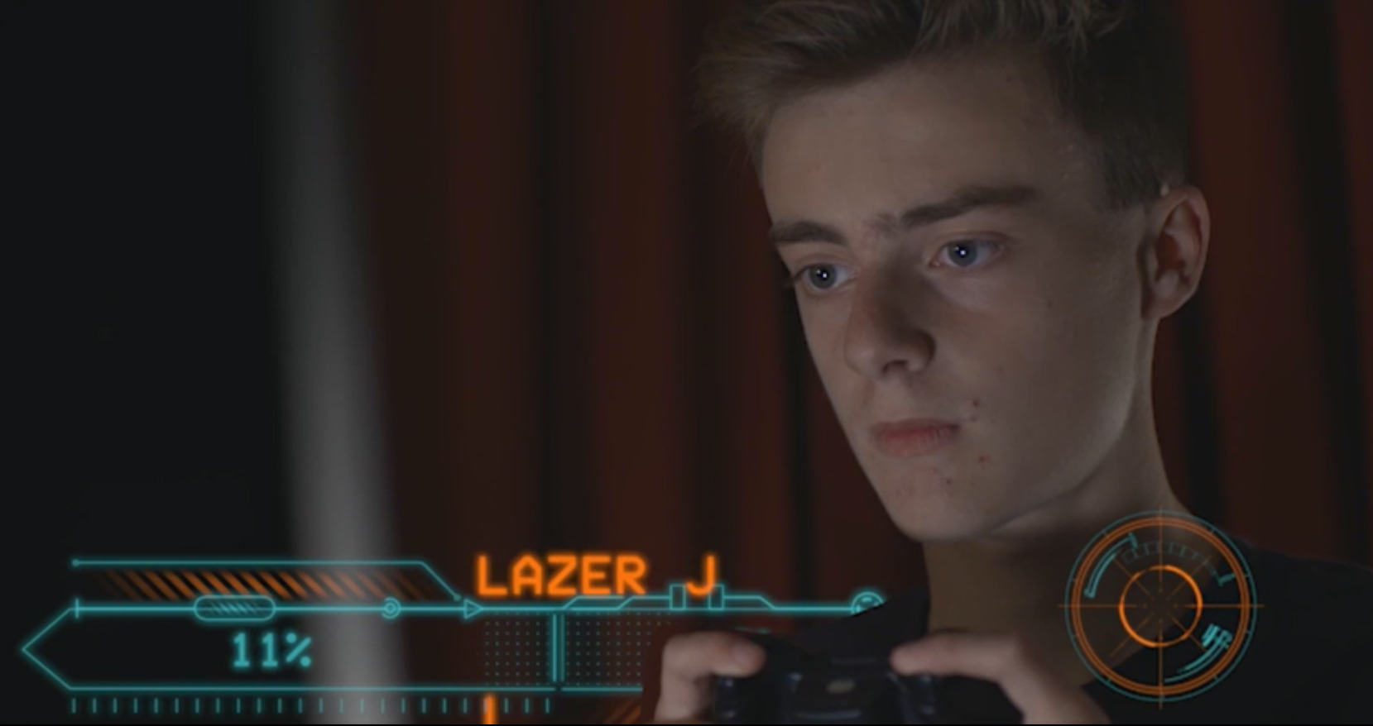
Watch “Gone too far”
http://www.childnet.com/resources/pshetoolkit/cyberbullying/gone-too-far

Slide 7
Is this film realistic? Could a similar situation happen in this school?
The title of this toolkit is called ‘Crossing the Line’. In this film, where do you think the line was crossed?
Why do you think Jason was bullied? Why do you think anyone is bullied?
Notes:
Suggested answers for teachers
2) When Charlie called Jason a gaymer, when they took pictures of him, when they spread pictures around?
3) Jason was new, Charlie was threatened by him, Jason seemed different?
4) He should have screenshotted the mean messages online, he should have told someone sooner, he should have remained calm and not retaliated; he ignored the messages after, he eventually told his sister

Slide 8
How did Jason respond to the cyberbullying? What could he have done differently? What did he do well?
Could Jason have done anything to stop the bullying? If yes, what could he have done?
What advice would you give to someone if they are being cyberbullied?
Notes:
Suggested answers for teachers:
4) He should have screenshotted the mean messages online, he should have told someone sooner, he should have remained calm and not retaliated; he ignored the messages after, he eventually told his sister
5) Tell a trusted adult sooner, blocked the users, reported the comments, not retaliated

Slide 9
In this film we see Jason being cyberbullied. How many people bullied Jason?
Are those who laughed along at the memes/funny pictures also involved in cyberbullying Jason?
Leah stands up to Charlie and tells him to stop. However, there are many others in the film who see what is happening to Jason but say nothing to help him. They are called bystanders. Who were the bystanders in this film? Why do you think they remained quiet?
Notes:
Suggested answers for teachers:
2) Bystanders: Jason’s other friends (Jenna, Ben), Remain quiet? For fear Charlie might target them, not to seem like a snitch, not to be seen like you can’t take a joke

Slide 10
Charlie says the word ‘gay’ a lot. He calls Jason a ‘gay-mer’ and he insinuates that Jason and Ben are boyfriends. Why does he call Jason gay? What does he mean by it?
Charlie also speaks about Jason’s ‘gay shoes’. If you use the word ‘gay’ to mean something bad or rubbish, what impact might it have on others, especially those who might be questioning their sexuality? What does the word ‘gay’ actually mean?
What can you do next time you overhear someone say the word ‘gay’ to mean rubbish or uncool?
Notes:
Suggested answers for teachers:
3) Call it out, or correct the person by offering other adjectives like ‘rubbish’ or ‘sad’ instead of ‘gay’

Slide 11
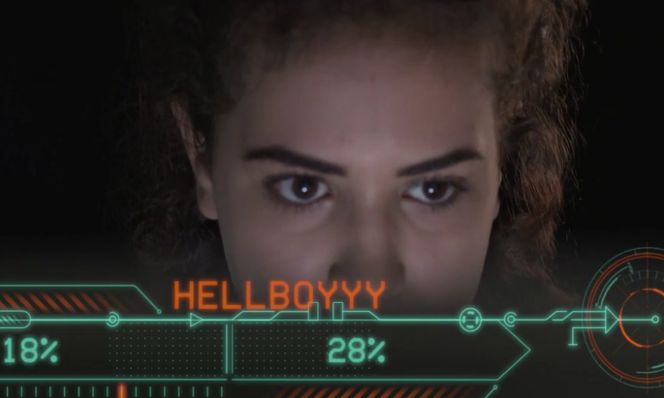
Can you think of any reasons for why Jenna might use a male avatar?
Do you think the internet is a welcoming place for girls?
Although Jason is cyberbullied in this film, research from Net Kids go Mobile 2014 says cyberbullying has increased and girls are more likely to be the target.
Although Jason is cyberbullied in this film, research from Net Children Go Mobile 2014 found cyberbullying has increased and girls were more likely to be the target.
In 2010, 8% of girls questioned had experienced cyberbullying, but in 2014, 15% had experienced cyberbullying.
Do you think girls have a harder time online? Why is this?
Notes:
Suggested answers:
1) Some girls may choose to have a male username to prevent unwanted attention or to be accepted into the gaming community, or to prevent males ‘going easy’ on them in games.

Slide 12
Activity -
What happens next?
In groups of 3 read worksheet 1.1 and
each chose a role.
Task: Imagining you are the characters from the film, write out a rough guide of a conversation that might take place between these characters.
If time, role-play the scenario.
5-7 minutes

Slide 13
Activity -
Triangle Six:
Banter -v- bullying
In groups of five, read worksheet 1.3 and
cut out the 6 scenarios.
Read the scenarios and put the ‘most serious’ cyberbullying incident at the top and the least serious at the bottom of a triangle.
8 minutes

Slide 14
Activity -
Walking debate
On either side of the room you will see a sign saying ‘CYBERBULLYING’ or ‘JUST A JOKE.’ You need to decide if the social media posts you are about to see cross the line from being a joke to cyberbullying.
The context won’t always be clear, so imagine you are just coming across these posts online and you don’t know the people involved.
10 minutes

Slide 15
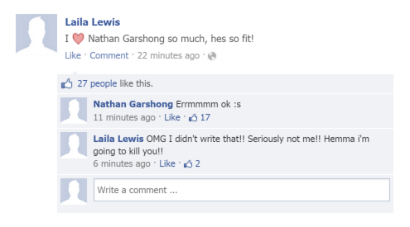

Slide 17
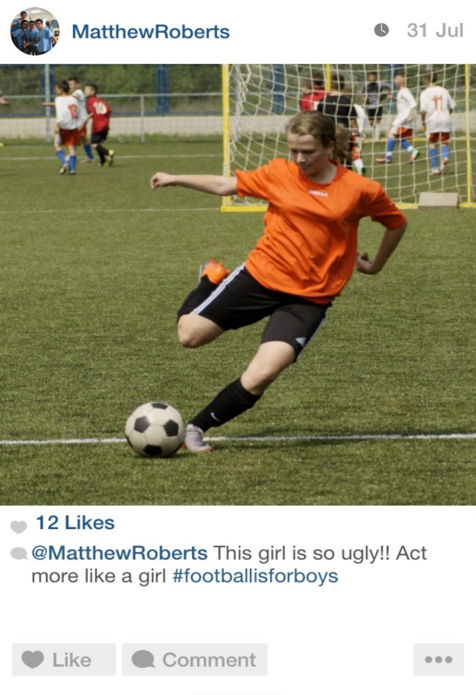

Slide 18
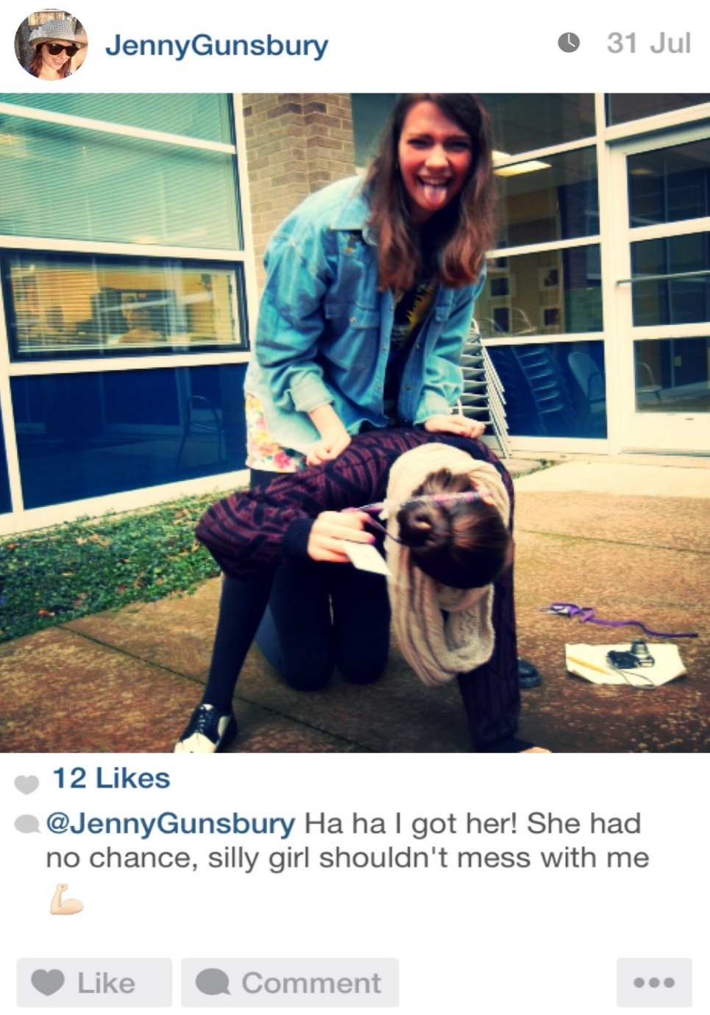

Slide 19
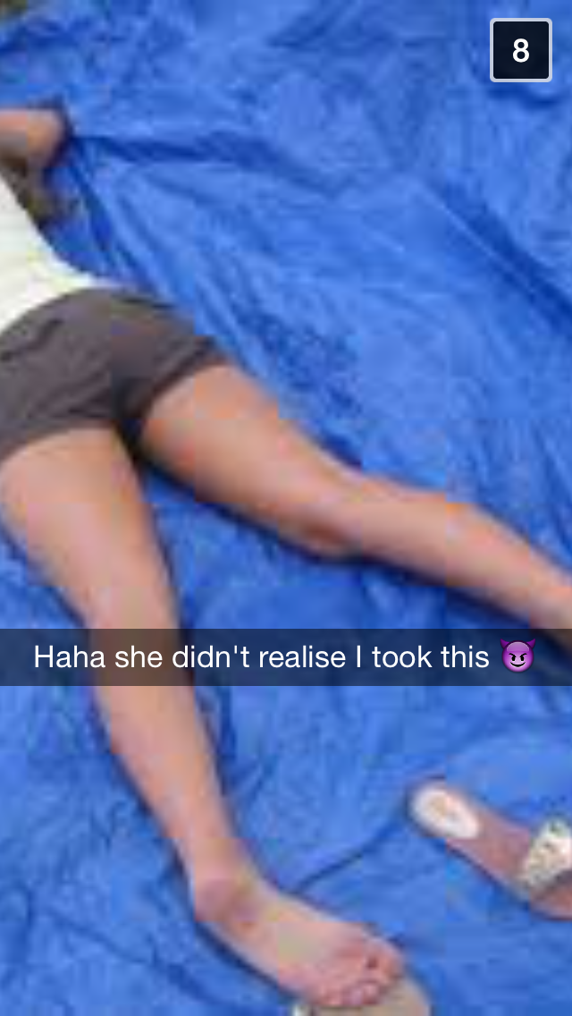

Slide 20
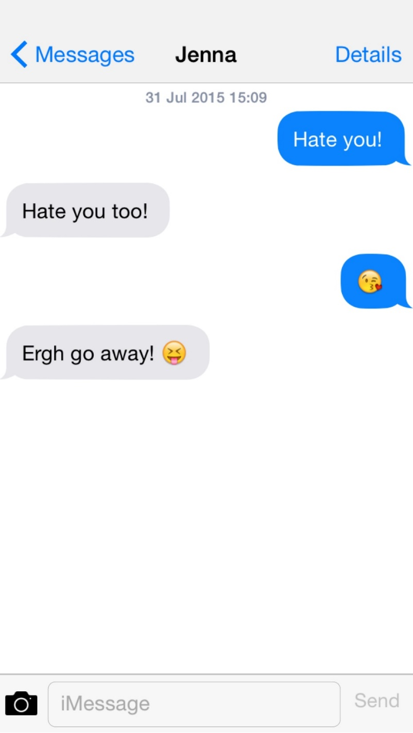

Slide 21
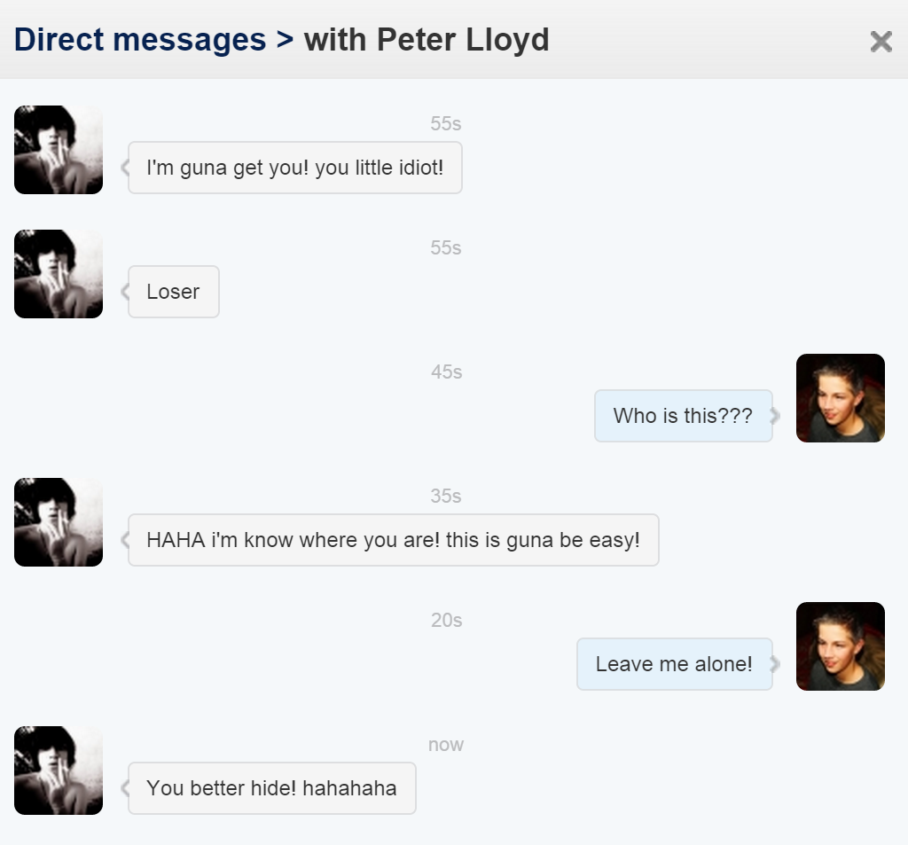

Slide 22
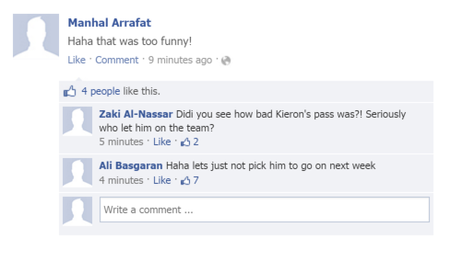

Slide 23
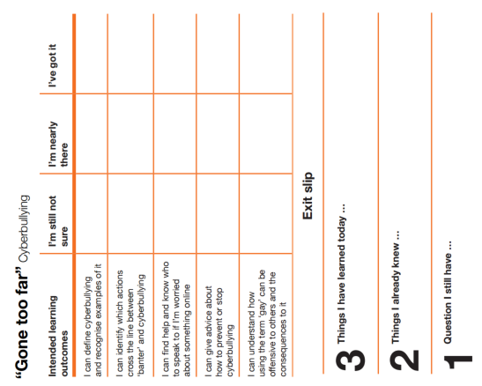
Do we still agree with our cyberbullying definition?
Where would you go for help?

Slide 24
Part of the
PSHE Toolkit
Available to download at:
www.childnet.com/pshetoolkit
Co-funded by
Crossing the Line PSHE toolkit 2016 by Childnet International is licensed under a Creative Commons Attribution-NonCommercial-ShareAlike 4.0 International License.

