Slide 1
All fun and games? Exploring respect and relationships online
What can we all do to play our part?

Slide 2
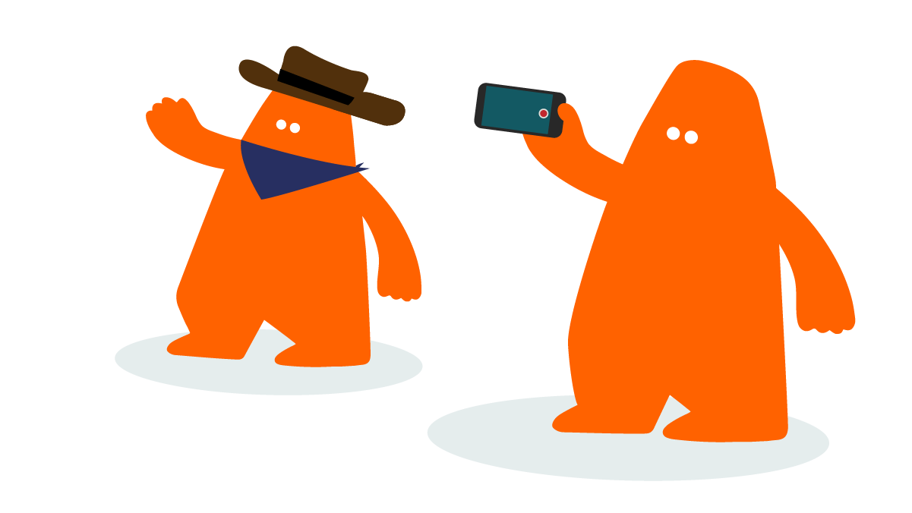
About Childnet
Childnet is a UK based charity whose mission is to work with others around the world to make the internet a great and safe place for children and young people.
The Childnet Film Competition International category encourages all young people across the world to get creative and make a two-minute film that shows positive use of the internet!

Slide 3
Why enter the competition?
You could win £500 for your school!
You will create a film that could help other young people stay safe online.
Best of all, you don’t need any previous experience as everything you need to help you along the way is in your competition pack.

Slide 4
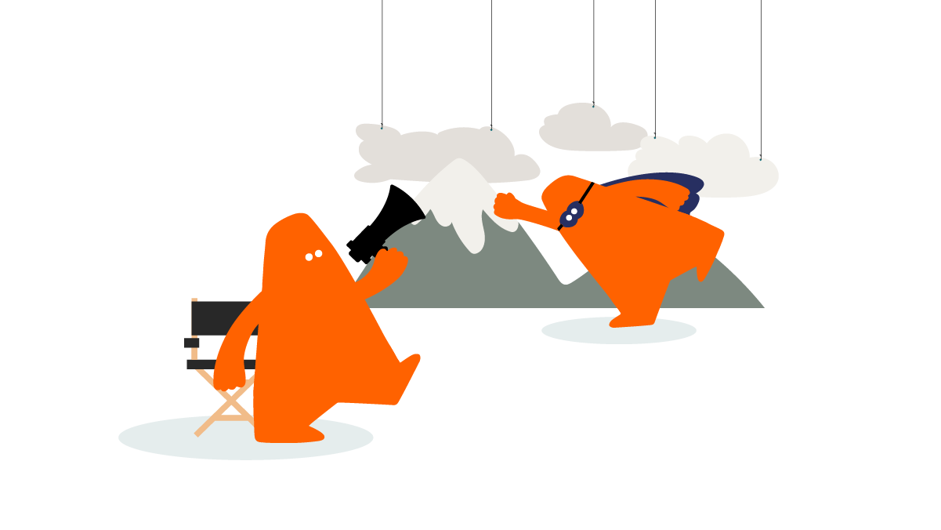
The challenge...
Create a two-minute film on the theme:
All fun and games? Exploring respect and relationships online
What can we all do to play our part?

Slide 5
What does the theme mean?
Use your planning sheet to jot down your thoughts about:
What makes going online and playing games online fun?
Why is it important to be kind and respectful online?
What could we all do to be kinder and more respectful online?
Example: Being kind online makes it more fun for everyone

Slide 6
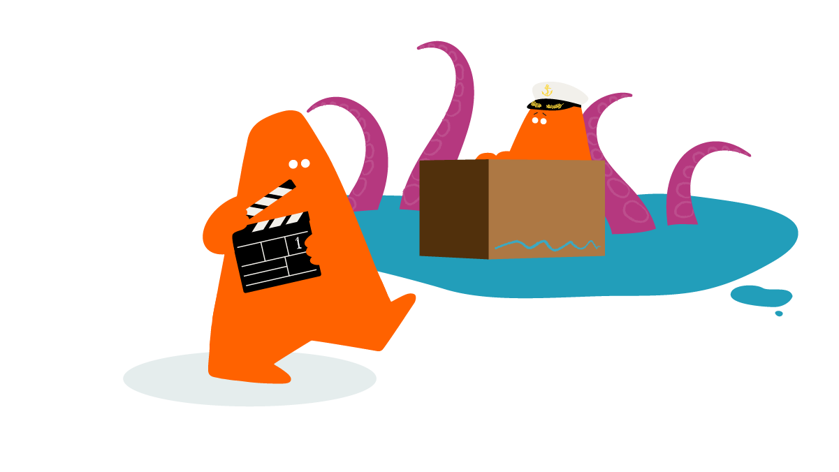
Over to you…
Step 1:
Using the table on your planning sheet, write down three different film ideas about the theme.
Step 2:
Number your ideas 1, 2 or 3 to decide your favourite film idea, the idea with the strongest message. Which one will you choose to be your film?

Slide 7
Over to you…
Step 3:
Decide your beginning, middle and end for your favourite film idea.
Step 4:
Choose the style of your film. Will it be a documentary, drama, news report, song, animation or perhaps a rap or spoken word?

Slide 8
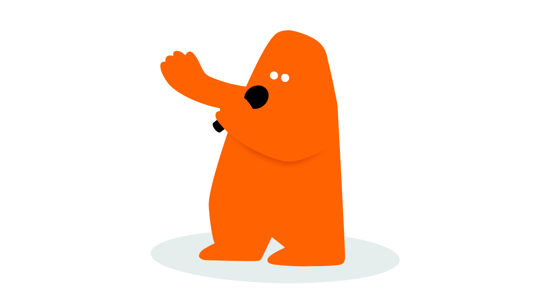
Copyright information
Do not include any known music tracks or images from a film or game.
Instead try to create your own song or images.
…and finally, don’t forget to watch last year’s winning films for inspiration!

Slide 9
Explore more resources at childnet.com/resources
© Childnet International 2022

