Slide 1
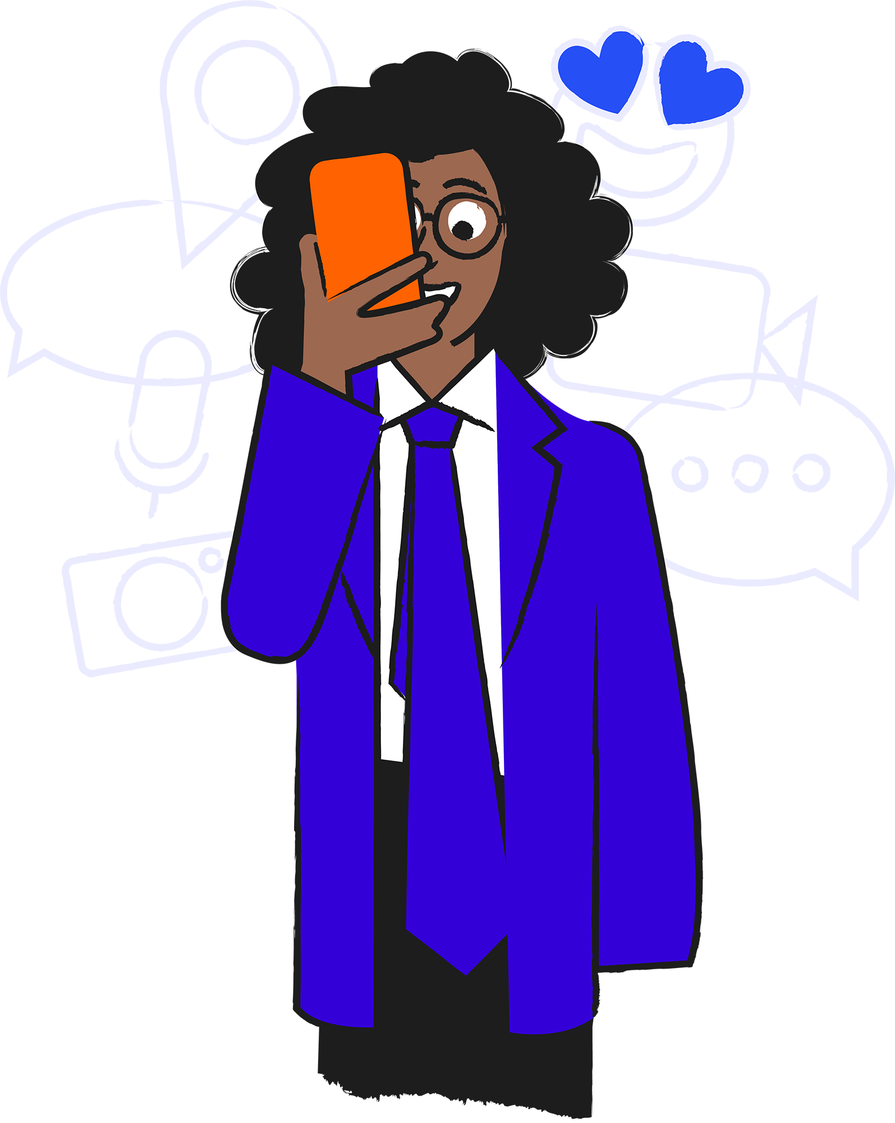
Moving on up!

Slide 2
Hands up if you…
Miss some of your old friends from primary school
Have made new friends at this school
Are the only person from your primary school at this school
Use technology to keep in touch with friends from primary school
Play games online with your friends

Slide 3
Moving on up!
In this lesson we will be looking at:
How new and old friendships can change when moving to a new, bigger school with a focus on the role that technology can play.
Learning objectives:
Describe how friendships can change when moving to a new, bigger school
Explain how best to respond to friend and follower requests online
Devise strategies to cope with online difficulties amongst friends

Slide 4
Appy friends
How can technology and apps help you keep in touch with friends and build new friendships?

Slide 5
Friend requests
What is a friend request?
When might someone get a friend request?
Do people ever get friend requests from people they have not met?

Slide 6
Yazmeen
Yazmeen has just started secondary school and has settled in well.
She misses her best friends from primary school, Shana and Maria, but she has met lots of new people and her class are really friendly.
Yazmeen is starting to get a few friend requests on social media and the games she plays.

Slide 7
What should Yazmeen do?
Delete, Accept, or Ask for help
A
Hey Yaz. Guess what? I have a phone now too. I miss you and Shana. She gave me your number. I hope we can keep in touch on here now. Big hugs. Maria
B
Hey lazertop693. You want to be on my squad next time? Add me and I’ll see when you are online. We’ll be unbeatable
C
Hey. You probably don’t remember me. I was at your old school. Add me here and we can meet up
D
Hey Yazmeen! I’m a friend of Shana. Luca

Slide 8
Accept
Yazmeen can accept this request from Maria. Maria is a good friend that she knows from her Primary School. It is possible that someone is pretending to be Maria but we can feel pretty confident that it is Maria from the message. If it turns out that it is not her friend Maria, Yazmeen should block and report them.
A
Hey Yaz. Guess what? I have a phone now too. I miss you and Shana. She gave me your number. I hope we can keep in touch on here now. Big hugs. Maria
Maria

Slide 9
This one is tricky
Yasmeen could accept it. Friends on games don’t see as much as they would on social media. It is possible to play games safely and enjoyably with people you don’t know but if the player did anything that worried Yazmeen she should go to an adult and use the block and report buttons on the game.
Yasmeen could ask for help to get some advice and decide what to do.
Yazmeen could also delete it because it is a stranger. This is the safest thing to do.
B
Hey lazertop693. You want to be on my squad next time? Add me and I’ll see when you are online. We’ll be unbeatable
topskillz1111

Slide 10
Ask for help
This person is talking about meeting up and Yazmeen cannot be sure who they are. Anyone could say they were an old friend from school and sadly some people will pretend to be someone else or simply message anyone.
After talking to an adult, it is best that they block and report the person too.
C
Hey. You probably don’t remember me. I was at your old school. Add me here and we can meet up
?

Slide 11
Ask for help
Luca is saying he is a friend of a friend but they might not be. This person might be a stranger who has seen Yazmeen mention Shana online in a comment or photo. Yazmeen could also ask her friend Shana to see if this is someone she knows. Even if it is genuine, the safest thing is to wait till she meets Luca and if they get on well, add him then.
D
Hey Yazmeen! I’m a friend of Shana. Luca
Luca

Slide 12
Friend requests: Top tips
Write down at least three top tips for handling friend requests
1.
2.
3.

Slide 13
Changing friends, changing friendships
Your task is to help some friends who have recently started secondary school.
For each situation you need to:
Find out what is happening
Think about how the friends are feeling
Write down your advice
Present your ideas to the class
Please note: There will be friendships that need repairing but there may also be scenarios where friendships have changed and people are drifting apart. If they are drifting apart try to help those friends adjust.

Slide 14
Class 7T
Help and advice…
Maya and Zack
How can technology and apps help you keep in touch with friends and build new friendships?
Not presenting?
Write down all the advice and ideas you hear. Put a star by the ones that use technology.
Mantas and Sam
Max, Osei, Dylan and Wassim
Emma and Chloe

Slide 15
Un-Appy friends
What do you think of this statement?
‘Technology
is terrible for
friendships.’

Slide 16
Explore more resources at childnet.com/resources
Co-financed by the Connecting Europe Facility of the European Union
© Childnet International 2022

